Slide 1




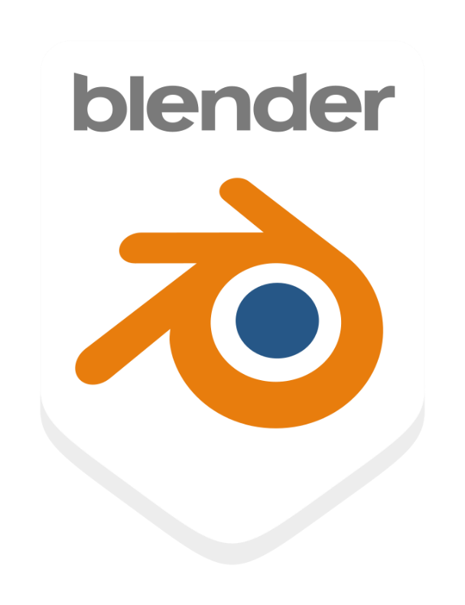

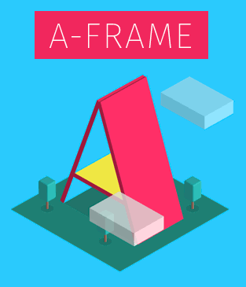

Evaluating and Selecting the Best Platform for 3-D STEM Simulations
Maxwell Baxley (MMB54078@uga.edu)
Faculty Mentors: Dr. Inseok Song (Song@uga.edu), Dr. Nandana Weliweriya (NandanaW@uga.edu)
3-D Software Comparison
Motivation
 | Benefits | Limitations | Capabilities | Price | System Requirements | VR Capabilities
Unreal Engine | Can make interactive simulations. Cutting-edge graphics and physics. Highly developed engine. | Written in C++, not very beginner-friendly. Supports VR, but FPS games are its main focus. | Best graphics of any other platform. Can create games, videos, and simulations. | Free! | CPU - Quad-core Intel or AMD, 2.5 GHz or faster Memory - 8 GB RAM Graphics - DirectX 11 or 12 | Great for creating VR applications. Can also create animations while using VR. Has face tracking features Can create both Android and Apple apps using a single code path.
Unity | Supports interactive simulations. Written in C+, Beginner-friendly. A strong community to help if you get stuck. | Not the best for large, complex programs | Can produce realistic, interactive games Can create games, videos, and simulations | Free! | CPU - X64 architecture with SSE2 support Graphics - DX10, DX11, and DX12-capable GPUs | Can make simulations in VR. Seems to be a little less user friendly when it comes to VR “[Can] deploy across multiple mobile and wearable AR devices” Has walk through tutorials for AR/VR
Blender | Can make interactive simulations. Free open-source 3D models already available. Open-source with a large community to help you. | Difficult to learn as a beginner, but gets easier. | Can do everything from animations to video editing to creating interactive games | Free! | CPU - 64-bit quad-core with SSE2 support Memory - 8GB RAM Graphics card with 2 GB RAM | Compatible with all types of VR. seems to be very user friendly.
Maya | Great graphics and realistic animations. Can work cross platform with Unreal Engine. Many tutorials on astronomical objects online.. | Not interactive. You must import it into another software to get interactivity. | Can port in large data sets. Great for Physics simulations like rigid bodies and particles. | $1,875/year per person | CPU - 64-bit Intel or AMD CPU, Apple M-series silicon using Rosetta 2 RAM - 8 GB minimum (16 GB+ is recommended) | You must export your animation to another software to turn it into VR.
A-Frame | Been used by organizations like NASA and CERN. Open-source with a large community. | A little more of an animated style rather than a realistic style. | Written in HTML, which is an easier language to learn. | Free! | “A-Frame can be developed from a plain HTML file without having to install anything.” | Works with any VR/AR headset. It also can be used as 360-degree computer software.
Traditional STEM education relies on static 2-D illustrations, hindering comprehension of 3-D scenarios.
We aim to create open-source, interactive 3-D simulations to enhance STEM learning experiences.
This project involves evaluating and selecting the most appropriate software platform for our simulations.
Method
Compiled list of top 3-D simulation platforms.
Conducted thorough research on each platform, assessing Benefits, Limitations, Capabilities, Costs, System Requirements, and VR/Mobile AR features, and documented findings in a shared spreadsheet.
Identified Unity and Blender as preferred choices due to intuitive interfaces, affordability, and strong mobile/VR support.
Also, this comparison helps the research team to identify potential grant opportunities for funding support.
Benefits
Future Work:
Immersive simulations will improve understanding of basic and complex concepts like solar eclipses and even more complex ones like parallax
Simulations will be hosted on our website for free access by colleges, high schools, and individuals with limited resources.
Code will be open-source, allowing modification to suit specific needs.
Next phase involves replicating a single simulation across different software for performance comparison.
The team aims to develop simulations, user interactive activities for various topics in Astronomy, Physics, and other STEM disciplines.
Scan me to learn more!

